Slide 1
PPRO Partner Connect
29 APRIL 2020

Slide 2
Introductions
Nice to meet you
Ronnie d'Arienzo
Chief Revenue Officer
rda@ppro.com
Ronnie is one of fintech’s most experienced and adept salespeople, combining a rare background in and understanding of both tech and finance. Before joining PPRO in 2016, Ronnie held senior strategic positions at large financial corporations, including American Express and Paysafe.
Elian Schweizer
Global Head of Product Management elian.schweizer@ppro.com Elian is responsible for the global product management team at PPRO. With PPRO since 2017, Elian is our in-house product expert. He and his team are responsible for the entire value chain for over 150 local payment methods: processing, collection, and acquiring.
Jennifer Archangeli
Product Marketing Manager
jennifer.archangeli@ppro.com Jennifer is PPRO’s Product Marketing Manager in the
product management team.
Prior to joining PPRO this year, she has been a product and content marketer for and with tech startups, SMBs, and enterprises such as Dell, Microsoft, and Nokia.
Matt Jackson
Head of Partner Development, EMEA matt.jackson@ppro.com Matt and his team manage relationships with PPRO’s key payment service provider partners, helping them grow and meet the demands of their merchants and consumers around the world. Before joining PPRO, he worked for companies like Microsoft and Paysafe Group.
James Booth
VP, Head of Partnerships, EMEA
james.booth@ppro.com James heads up the new business and partner development teams across EMEA. Over the last 5 years, he’s helped build PPRO’s global partnership base and helped drive several strategic initiatives including the establishment of PPRO in North America. James has 10 years of experience in the FinTech sector working for Payleven and Investec.
‹#›

Slide 3
Agenda
Introduction
Brief welcome and PPRO overview
Overview of the local payments landscape
How local payment methods overtook cards as the lever for growth
Local payment methods you need to know about
BLIK, MyBank, WeChat Pay & GrabPay
5 top tips for selling LPMs
How to add value to your offering, increase transactions, and hit your targets
Resources for PPRO partners
E-commerce insights and tools designed to make you the expert
Q&A

Slide 4
Introduction
1.
Ronnie d'Arienzo | Chief Revenue Officer

Slide 5
How PPRO works
A powerful platform-as-a-service
Watch the video to learn more
Notes:
Local payment types include e-wallets, bank transfers, local (or domestic) card schemes, cash-based payment methods, deferred credit schemes, and more.
PPRO is a specialist provider of local payment methods from all over the globe, helping PSPs and their merchants grow, be more efficient, and stay secure. We provide a multitude of LPMs that you can offer to your merchants so they can access both domestic and cross-border consumers.
PPRO partners get access to our LPM platform via a single contract and single API – eliminating the hassle of contracting and technical maintenance. An important note here is that we stay whitelabelled – in the background – so you can manage the relationship entirely with your customer.

Slide 6
Overview of the local payments landscape
2.
Ronnie d'Arienzo | Chief Revenue Officer

Slide 7
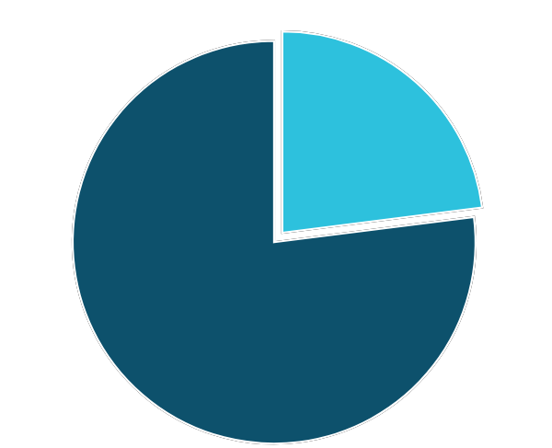
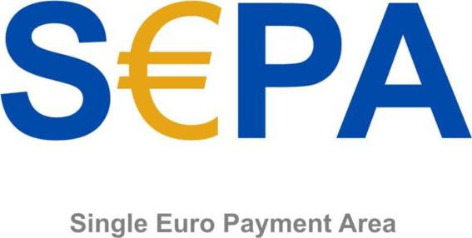
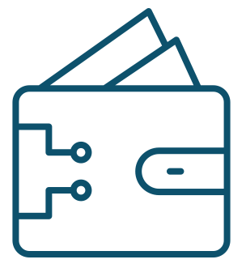
International credit cards VS local payment methods
Bank Transfers
23%
E-wallets
Cash Payment Schemes
77%
Local Card Schemes
Local
Local
Deferred credit schemes
Notes:
What we consider to be “local payment methods” are sometimes referred to as “alternative payment methods.” However, as you can see by the incredible statistics around the use of these payment methods, the term “alternative” is misleading. Globally, local payment methods are the dominant way to pay online.

Slide 8
Credit cards are forecast to be
less than 19% of global
e-commerce by 2023.
Worldpay Global Payments Report
Notes:
The overall value of e-commerce is increasing, and the market share of cards will decrease.

Slide 9
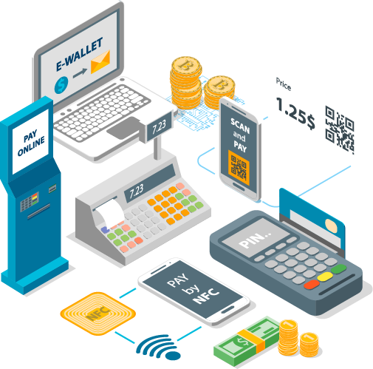
Local payment methods are a lever for growth
The e-commerce market share of
international cards is stagnating
The established card acquiring model in markets like the US and UK has historically dominated the payments narrative due to the legacy banking corporations who established the existing card rails. But that’s changing.
Global acceptance of international cards is surprisingly low: Across various markets – including significant ones like China and The Netherlands – acceptance of international branded cards is surprisingly low.
Formerly called “alternative payment methods,” they are no longer the alternative.

Slide 10
Local payment methods you need to know about
3.
Jennifer Archangeli | Product Marketing Manager

Slide 11
How do you take your coffee or tea?
Each region has different preferences, determined by various
cultural factors
Notes:
Culture determines behaviour and preferences: Italians like their Cappuccino, Germans a bitter filter coffee, Americans brown water and Brits prefer tea. The same theory applies to payment methods.

Slide 12
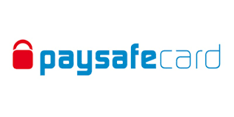
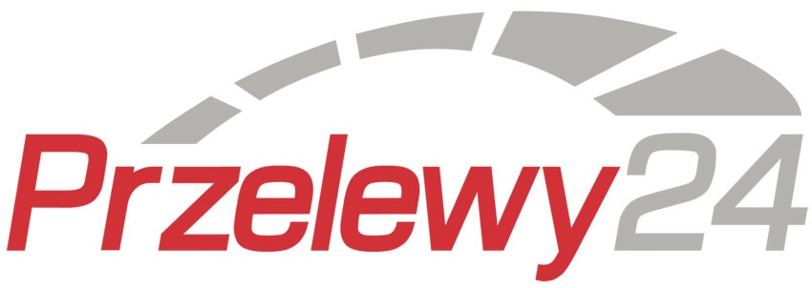
As commerce becomes more global,
payments become increasingly local
Europe
LATAM
APAC
Local
Local
Local
Local
Local
Notes:
There are over 450 significant local payment methods in the world.

Slide 13
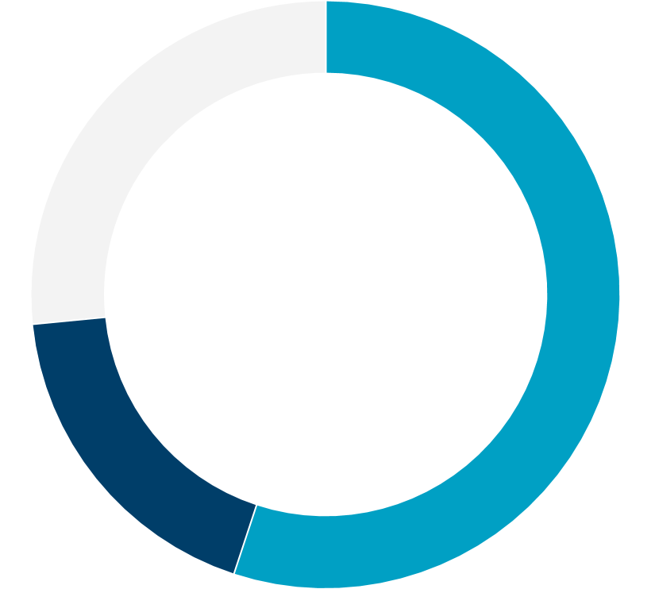
Consumer preferences and payments
Merchants can maximise conversions using local payment methods
Why do 20% of online shoppers* abandon their cart?
40% shipping costs too high
33% price comparisons
20% preferred payment method not available
15% delivery time too long
12% website too slow
12% security concerns
11% lack of details on returns
8% preferred delivery option not available
Average cart abandonment rates are estimated between
60% - 80%
Consumers across the UK, France, Spain, Italy, Belgium, Switzerland, The Netherlands and Germany: B2C Europe 2018

Slide 14
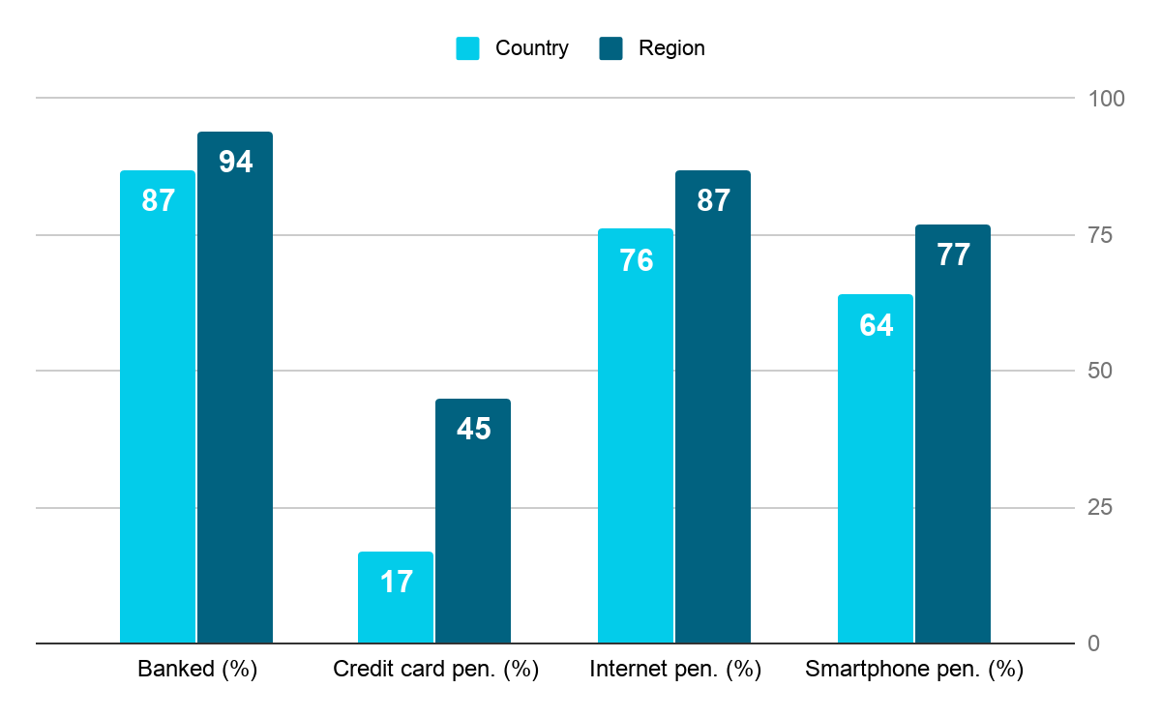
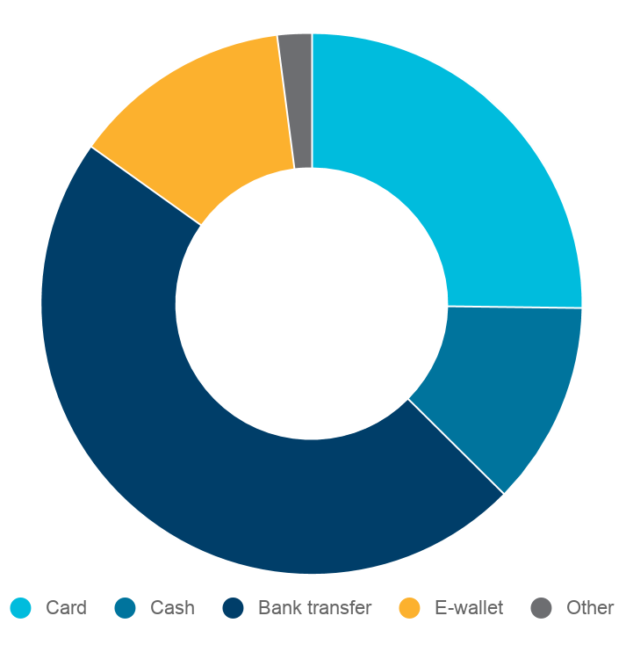
Poland
Population: | 38 million (28.9 million online)
B2C e-commerce: | $11.8 billion which is 5% of total retail
E-commerce growth: | 11%
GDP: | $585.8 billion
GDP per capita: | $15,424
Average online spend: | $645
Mobile e-commerce: | 39%
Cross-border e-commerce: $0.7 bn
6% of total e-commerce
Top e-commerce segments
16% shop cross-border
Clothing & Footwear: 18%
Homeware & Furniture: 13%
Airlines & Hotels: 12%
Electrical Goods: 11%
Food & Drink: 11%
China: 18%
Germany: 14%
UK: 10%
2%
13%
25%
Payment method breakdown
12%
47%

Slide 15
BLIK
Poland | Bank transfer | Global merchants
Joint venture 6 largest PL banks
8.39M BLIK users
Launched in 2015 > created and developed in PL
13 banks available
90% PL banking customers
Accessible in 12 mobile banking apps
6.5 times growth since 2017
218M TXN in 2019
70% BLIK TXN are e-commerce
When checking out online select the BLIK payment option.
Copy your BLIK code from your bank app and click pay.
Confirm the transaction using your PIN in your bank’s app.
You’re done!

Slide 16
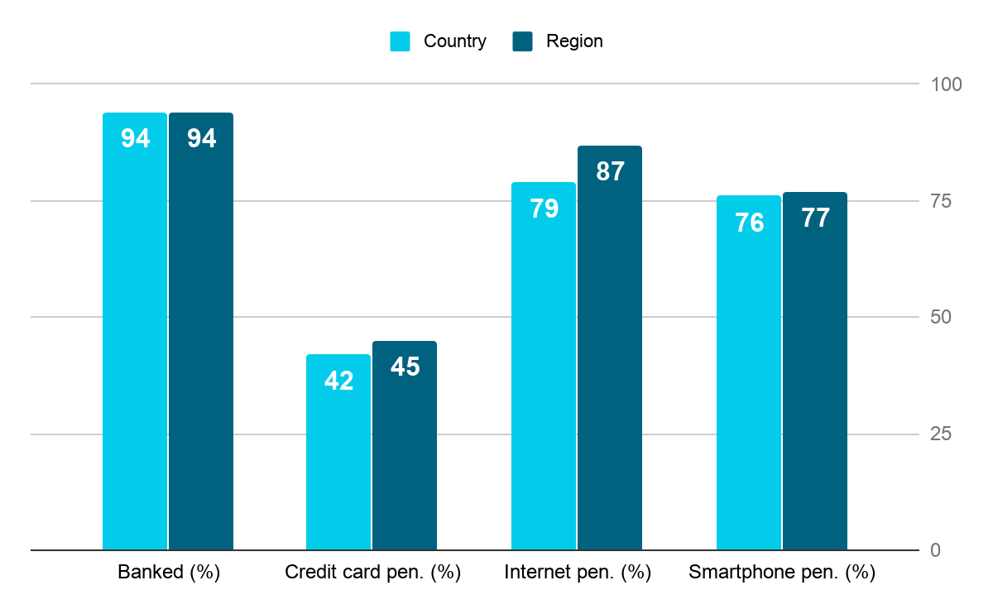
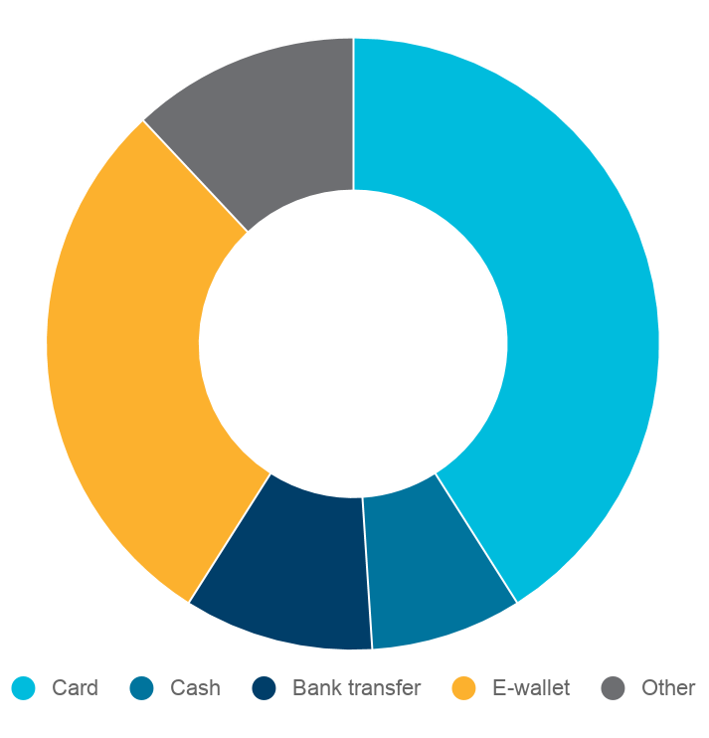
Italy
Population: | 60.4 million (47.7 million online)
B2C e-commerce: | $32.9 billion which is 4% of total retail
E-commerce growth: | 16%
GDP: | $2.1 trillion
GDP per capita: | $34,318
Average online spend: | $1,510
Mobile e-commerce: | 41%
Cross-border e-commerce: $6.6 bn
20% of total e-commerce
Top e-commerce segments
51% shop cross-border
China: 35%
UK: 19%
Germany: 19%
Airlines & Hotels: 19%
Clothing & Footwear: 15%
Electrical Goods: 12%
Homeware & Furniture: 8%
Health & Beauty: 7%
12%
Payment method breakdown
41%
29%
10%
8%

Slide 17
MyBank
You’re done!
Italy + Spain | Bank transfer | EU merchants
Owned by subsidiary of EBA
40M account owners
Launched 2013 > based on SEPA standards
Enabled by 250+ banks
11k b2b/b2c merchants
IT public sector uses MyBank for payments by residents
No payment limits
€15B payment TXN
Over €20M daily TXN value as of Dec 2019
When checking out online select the MyBank payment option.
You’ll be directed to your online banking portal, where you’ll be able to log in and verify payment details.
Authorise the payment. In a few seconds, you and the merchant will receive confirmation of payment.
You’re done!

Slide 18
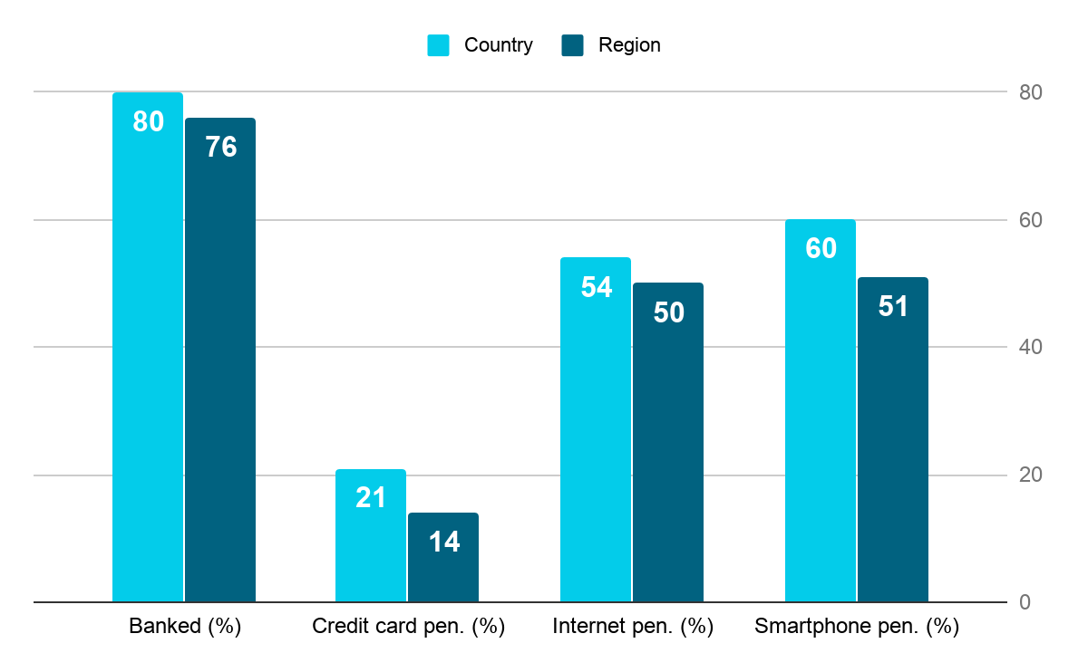
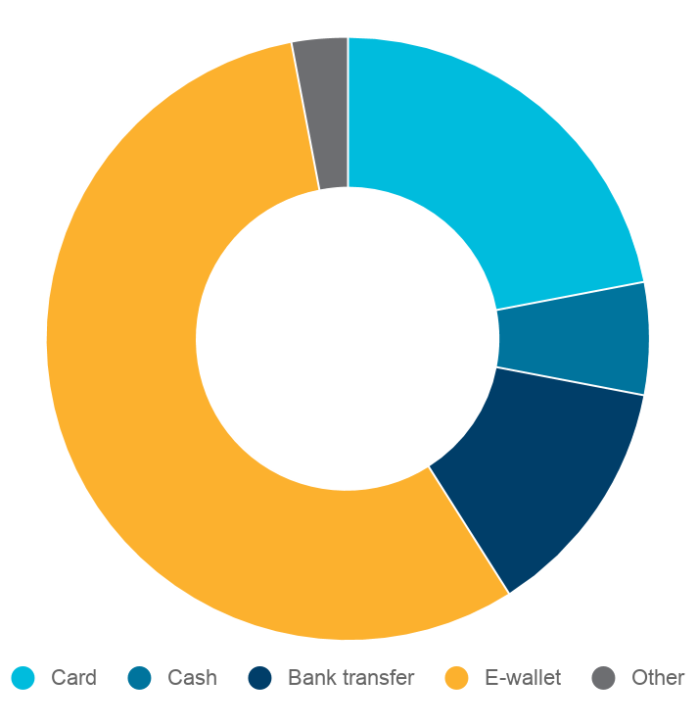
China
Population: | 1.4 billion (756.3 million online)
B2C e-commerce: | $1.3 trillion which is 24% of total retail
E-commerce growth: | 24%
GDP: | $13.6 trillion
GDP per capita: | $9,771
Average online spend: | $2,386
Mobile e-commerce: | 59%
Cross-border e-commerce: $217 bn
17% of total e-commerce
Top e-commerce segments
43% shop cross-border
Japan: 23%
USA: 14%
Hong Kong: 12%
Clothing & Footwear: 17%
Airlines & Hotels: 15%
Electrical goods: 14%
Food & Drink: 11%
Homeware & Furniture: 10%
3%
22%
Payment method breakdown
6%
56%
13%

Slide 19
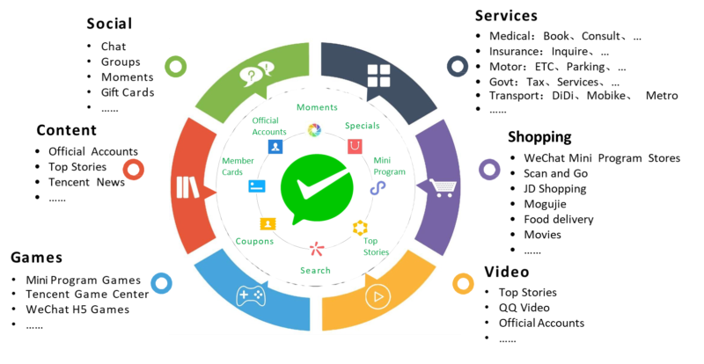
WeChat Pay
China | E-wallet | Most EU + UK merchants
e-Wallet in WeChat super app
Over 1.12B WeChat MAU
92% WeChat users use WeChat Pay (2017)
WeChat Pay launched in 2011
800M WeChat Pay MAU
300k merchants support WeChat Pay outside of CN > 50M total
~1B daily WeChat Pay TRX
$16T payment TRX value (2017)
38.9% market share CN mobile payments > Alipay no.1, 53.8%
DMR 2020

Slide 20
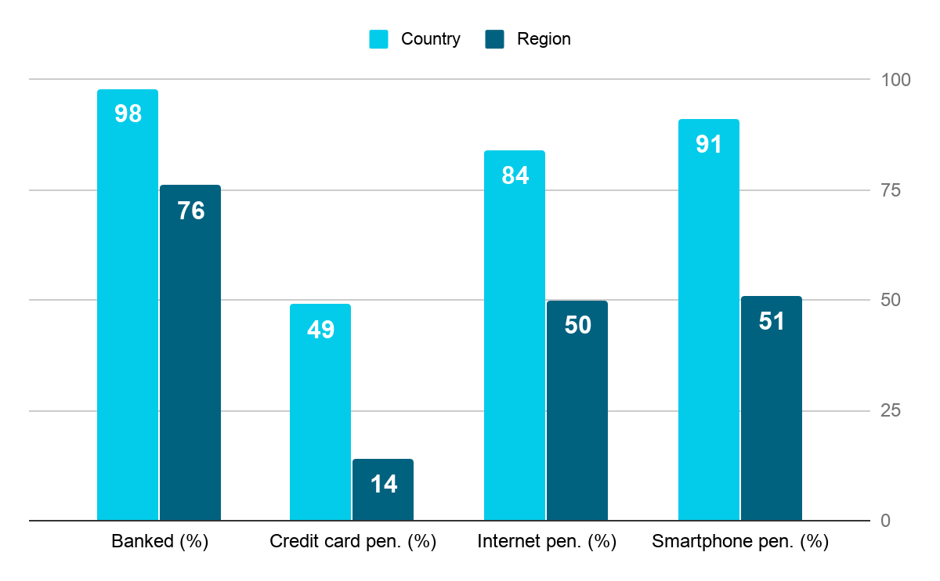
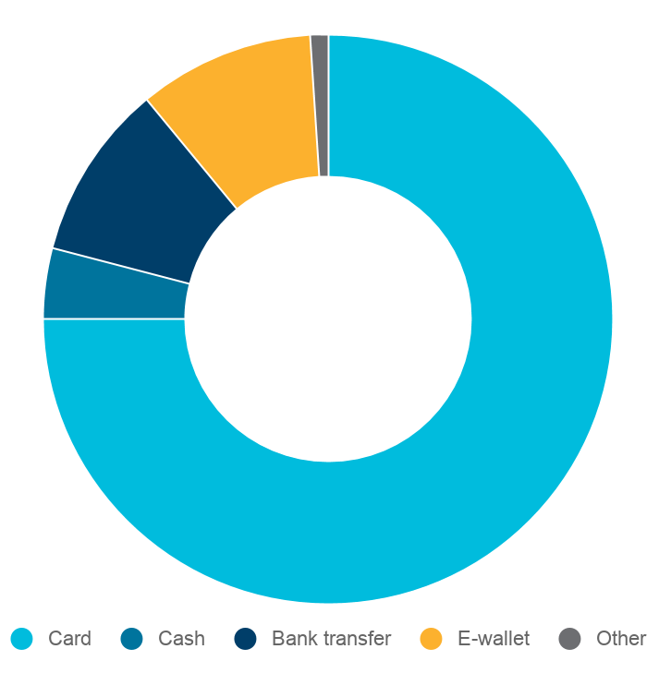
Singapore
Population: | 5.6 million (4.8 million online)
B2C e-commerce: | $5.6 billion which is 6% of total retail
E-commerce growth: | 13%
GDP: | $364.2 billion
GDP per capita: | $64,582
Average online spend: | $1,648
Mobile e-commerce: | 47%
Cross-border e-commerce: $2 bn
35% of total e-commerce
Top e-commerce segments
73% shop cross-border
Airlines & Hotels: 29%
Clothing & Footwear: 12%
Electrical goods: 11%
Food & Drink: 10%
Health & Beauty: 8%
China: 43%
USA: 20%
South Korea: 8%
1%
10%
10%
4%
Payment method breakdown
75%

Slide 21
GrabPay
Singapore | E-wallet | Global merchants
e-Wallet in Grab super app
115M Grab customers
Grab: No.1 brand SG, 18-34y GrabPay: No.1 e-wallet SG
4M GrabPay Users in SG (87% pop)
75% daily consumer usage
2M SG consumers underbanked (only bank accounts)
GrabPay markets
SEA coverage growing
Current: SG, MY, PH, TH
Future: ID, VT
When checking out online select the GrabPay payment option.
Enter a mobile phone number and receive a verification code to authorise payment.
Review your transaction details and confirm the payment.
You’re done!

Slide 22
5 top tips for selling LPMs
4.
Matt Jackson | Head of Partner Development, EMEA
Notes:
PPRO’s strategy is based around the idea of consumer centricity. I think this is best described by the need for PPRO to not only our understand our direct customers, you - the PSP’s - but also YOUR customers, the merchants. Not only that but all of us in the chain need to really understand the end consumers, the individuals buying things online and offline.
This is an evolution of the idea of a channel centric approach where merchants provide solutions based on the channel a consumer is using to buy from them - instead we have seen the market create solutions for the individual. This can be how they like to be marketed to, on which device they like to purchase, at what time of the month, and importantly for all of us, which method they like to use to pay with.

Slide 23
There are over 450 significant LPMs in the world
Here’s how to be the expert … without being an expert
Notes:
The world of local payments is complex. There are over 450 significant local payment methods across the globe. It’s impossible to know and understand them all. As you’ve seen, each payment method is vastly different. There are nuances between regions, countries, and industries that can make or break conversion. We recognise that it’s difficult.
As partners, we provide you with several ways to find the perfect payment methods for boosting conversion for your customers.
What we are trying to do is give you process that you can use again and again across your merchant base, either new business opportunities, or existing accounts to drive growth in volume and stickiness to your company.
Identify which LPMs are important, and then how to talk about them with your merchants, highlighting these benefits that speak to the pain points of your merchants
The first important thing is to know your customer and their customer. From there, you can make progress by:
Understanding all the different LPMs (we make this easy)
Talking about how conversion rates will lift when merchants implement LPMs
Stressing the benefits of lower fraud risk and guaranteed payments
Discussing pricing

Slide 24
Tip 1: Know your customer (the merchant)
Industry
Travel, retail, gaming, software, etc.?
Geography
Where is the merchant located?
Where are their customers?
Where do they want to expand?
Types of products
Physical goods? Digital? Experiences?
ATV
Some payment methods are suited to particular ticket sizes.
Existing payment mix
What methods is the retailer already offering? Are the methods full feature?
Notes:
By knowing your merchants, you can apply certain filters to narrow the amount of LPMs from more than 450 to something much more relevant to them.
Firstly, let’s consider the industry they are in: Are there any licencing restrictions? Do the local payment schemes support this industry? For instance, P24 do accept forex merchants, whereas WeChat Pay do not.
Geography is obviously hugely important and relates to the consumers but also important is what markets can your merchant sell to? Logistically, what can they support? The cross-border opportunity for merchants cannot be ignored and payment methods are placing more and more importance on this; iDEAL state that 20% of their business is done with non-Dutch domiciled merchants.
What types of products are they selling? This could even have a bearing on when, at which point in the transaction, the merchant should ship the goods and, like PSPs, schemes have different risk appetites for verticals and products.
Some payment methods are suited to particular ticket sizes. For example, a retailer with small tickets probably doesn’t need to offer Klarna, an instalment payment method.
What payments are they already offering? Who provides them? Do they have a full feature set? At what price are they getting those methods? All of these should have an important bearing on the proposals you are putting together. Not all local payment methods are implemented equally. PPRO is particularly proud of some of the work we have done in enabling refunds on some schemes that don’t offer this natively.

Slide 25
Tip 1: Know your customer’s customer
Location
This will help you whittle down to the most popular payment methods in their region – the ones they are likely to use.
Age
This can tell you their comfort level with certain payment methods.
Security
preference
Do they want to remain anonymous?
Culture
Various countries are averse to the debt credit cards can mean, are more security-conscious, or prefer to pay after delivery, etcetera.
Form factor
Do they want to use a QR code? Will they be using offline and online channels?
Notes:
When selling local payment methods to your merchants, you want to highlight the importance of customer centricity. They likely spend a lot of time and resources on coming up with the right marketing campaigns, designing a site that’s slick, and easy-to-use. But all of that will fall apart if the payment methods on offer don’t suit the customer’s payment preferences.
With cart abandonment rates as high as 70%, your merchants can’t afford to forget this crucial, final step of the transaction.
To maintain a payment experience that’s customer centric, there are a handful of things you want to focus on.

Slide 26
An example
Boosting conversion in
The Netherlands
A mid-market American clothes brand wants to expand in Europe by branching out to the Netherlands. Currently, they only offer the major card types and PayPal. Which is what works for their US and UK consumers.
However, in the Netherlands:
Over 58% of all e-commerce transactions are made using iDEAL.
Less than 20% of e-commerce purchases are made with a card.
By not offering iDEAL, the retailer is missing out on the majority of the market.

Slide 27
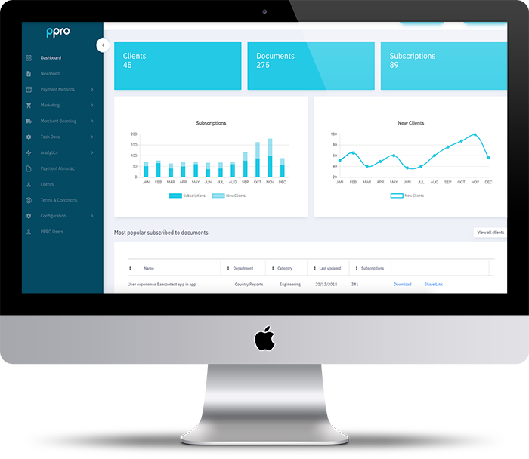
Tip 2: Understand your LPMs
Easy ways to be the expert on hundreds of payment methods
Start with the PPRO FAQ Document. Once you have whittled down your selection, you can find detailed information in a few places:
Partner Portal - featuring real-time data and tools to help you communicate more efficiently with merchants and share white-labelled information, up-to-date information on LPMs, and more.
Product Sheets - a snapshot of all the relevant product info that you can send white-labelled to your merchants
UX Documents - showing the customer experience step-by-step

Slide 28
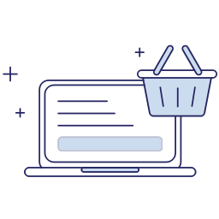
Tip 3: Amplify conversion rates
44% of UK shoppers
abandoned cart due
to not being offered their
preferred payment method*
Consumer Market Survey, PPRO 2020
Notes:
Conversion rates for a merchant should indicate the success rate after a shopper arrives at a checkout page. PPRO’s recent research has in the UK has suggested that 44% of shopper abandon the checkout, as they can’t pay with the method that they want! This is in a market that is famous for not really adopting new payment methods at scale.
Conversion once the shopper has selected their payment method is also an important consideration. If we look at bank transfer payment methods, we often see really high conversion rates. This comes down to familiarity for the shopper. PayByBank App in the UK, and with other markets to come, have done a good job of allowing consumers to use familiar checkout flows through their own banking app.

Slide 29
Tip 4: Lower risk of fraud & guarantee payments
Over 80% of the LPMs on PPRO’s platform carry no risk of chargeback
$6.4 billion projected merchant losses to e-commerce fraud by 2021, according to Aite Group*
69% of the LPMs on PPRO’s platform offer a Payment Guarantee
Finextra
Notes:
This stat taken from a report by the Aite group shows the full scale of the issue. A lot of the schemes have been designed around protecting from this issue by becoming push payments; the consumer has to authorise the transaction. This not only protects the merchant from financial loss, but also allows for higher conversion rates as merchants do not have to worry rejecting orders to protect themselves from fraudsters.
Indeed 80% of the LPMs on our platform carry no risk of chargeback.
LPMs are the sole answer to this problem but ensuring your merchants offer the right payments mix is part of the solution.
Many schemes are now looking to implement instant payments, and 69% of our products offer a payment guarantee at the time a transaction moves to successful status. It’s also worth noting that typically the settlement times for local payment methods are less than 5 days with some credit cards being as many as t+27.

Slide 30
Tip 5: Pricing
An example from a large PSP’s website
On a €100 transaction:
The average totals of Visa / Mastercard that have been quoted are likely to be based on Intra EEA interchange fees which range between 0.20% (debit) and 0.30% (credit).
To match the fees in the this example the ATV would need to be €27.78
iDEAL MSC = €0.25
Mastercard MSC = €0.90
Visa MSC = €0.90
Notes:
The advertised rates from a large PSP – not one of PPRO’s partners – show the mapped out charges a merchant would face for a €100 transaction. You’ll note that, for iDEAL, the merchant would be charged 25 cents. But for both Visa and Mastercard, this would be 260% higher at 90 cents.
Further, for the charges to reach parity, the transaction value would need to drop to €27.78.

Slide 31
Resources
5.
Matt Jackson | Head of Partner Development, EMEA
Notes:
In summary:
Identify your merchant characteristics
Identify the end consumer characteristics
Use the PPRO tools to zoom in on the relevant local payment methods
Highlight the key features such as conversion and consumer preference
Discuss price to build the case for LPM implementation

Slide 32
A whole world of payments insights at your fingertips
Get FREE almanacs in the mail
Scan the QR code or visit www.ppro.com/order-your-free-almanac/
Explore new markets, optimise your payments mix, and increase conversion in every corner of the world.
Insights for 60 e-commerce markets
Over 490 local payment methods*
Exclusively for PPRO partners
Thousands of hours of research
The distilled knowledge of our global team of payment experts
*Not all LPMs covered in the almanac are available on PPRO’s platform.
The index is an objective view at all the significant payment methods across the globe.
View the Digital Almanac at https://legacy.ppro.com/almanac/
Notes:
As part of our mission to give you the technology, payment methods, and knowledge you need to grow your business - we provide a wealth of industry insights and data. A huge part of that offering is our PPRO Payment Almanac, published with research by Edgar Dunn & Company, and a distillation of our team of internal experts.
This is the objective view of local payments, so we cover everything across the industry – not just the 150 LPMs on our platform.
It’s only available for our partners, which is this group. If you’d like the new version for 2020, which is to be launched in just a few short weeks, do head to the order form here.

Slide 33
Additional Resources
Quick Links
PPRO Partner Portal
Videos: Local Payment Types and PPRO Partner Model
The Online Almanac
Order printed almanacs here
Regional Reports
Middle East & Africa
Asia Pacific
Central & South America
North America
Western & Central Europe
Eastern Europe and the CIS
Our Newsroom with reports, blogs, and more

Slide 34
Q&A
6.
James Booth | VP, Head of Partnerships, EMEA

